Slide 1

倒计时
Ablock创客教育
Notes:
更多模板请关注：https://haosc.taobao.com

Slide 2
目录
CONTENTS
01
Part one
知识回顾
02
Part two
画奥运五环
03
Part three
课后作业

Slide 3
01
Part one
知识回顾

Slide 4

知识回顾
命令 | 说明
turtle.backward (distance) | 向当前画笔反方向移动distance像素长度
turtle.forward(distance) | 向当前画笔方向移动distance像素长度
turtle.right(degree) | 顺时针移动degree°
turtle.left(degree) | 逆时针移动degree°
turtle.pendown () | 落笔
turtle.penup () | 抬笔
turtle.goto(x, y) | 将画笔移动到坐标x，y的位置
turtle.circle(r, ext,steps) | 画圆，参数半径，弧度和边数
turtle.setheading(angle) | 设置画笔朝向为angle角度

Slide 5
知识回顾
命令 | 说明
turtle.pensize(size) | 设置画笔的粗细
turtle.fillcolor(colorstr) | 绘制图形的填充颜色
turtle.pencolor(colorstr) | 绘制图形的画笔颜色
turtle.color(color1, color2) | 同时设置pencolor=color1,fillcolor=color2
turtle.begin_fill() | 准备开始填充图形
turtle.end_fill() | 填充完成

Slide 6
知识回顾
命令 | 说明
turtle.clear() | 清空窗口，但turtle的位置和状态不会改变
turtle.reset() | 清空窗口，重置turtle状态为起始状态
turtle.setup(w,h, startx, starty) | 设置画布大小
turtle.screensize(w, h, bg) | 设置画布大小，参数分别为画布的宽(单位像素), 高, 背景颜色
turtle.setpos(x, y) | 移动到x，y位置
turtle.speed(speed) | speed为0-10的整数(1-10越来越快,0表示最快
turtle.shape(name) | 设置画笔形状，arrow|turtle|circle|square|triangle|classic
turtle.hideturtle() | 隐藏画笔
turtle.showturtle() | 显示画笔

Slide 7
知识回顾
import turtle
turtle.pencolor("red")
turtle.fd(100)
input("请随便输入一个文字，继续下面的程序")
turtle.reset()
turtle.circle(100)
turtle.done()
turtle.clear()
clear() 清空窗口，但turtle的位置和状态不会改变
reset() 清空窗口，重置turtle状态为起始状态

Slide 8
02
Part two
倒计时

Slide 9
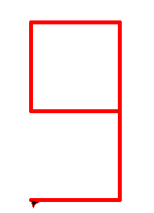
倒计时
import turtle
import time
turtle.pencolor("red")
turtle.speed(0)
turtle.pensize(5)
# 9
turtle.pu()
turtle.goto(40,0)
turtle.pd()
turtle.seth(45)
turtle.circle(80,-360,4)
turtle.seth(-45)
turtle.circle(-80,180,2)
time.sleep(0.7)

Slide 10
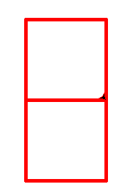
倒计时
turtle.clear()
#8
turtle.pu()
turtle.goto(40,0)
turtle.pd()
turtle.seth(45)
turtle.circle(80,-360,4)
turtle.seth(-45)
turtle.circle(-80,360,4)
time.sleep(0.7)

Slide 11
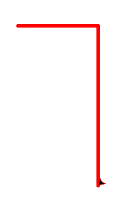
倒计时
turtle.clear()
#7
turtle.pu()
turtle.goto(40,0)
turtle.seth(45)
turtle.circle(80,-180,2)
turtle.pd()
turtle.circle(80,-180,2)
turtle.seth(-45)
turtle.circle(-80,90,1)
time.sleep(0.7)

Slide 12
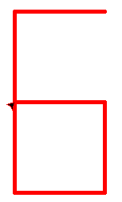
倒计时
turtle.clear()
#6
turtle.pu()
turtle.goto(40,0)
turtle.seth(45)
turtle.circle(80,90,1)
turtle.pd()
turtle.circle(80,180,2)
turtle.seth(45)
turtle.circle(-80,360,4)
time.sleep(0.7)

Slide 13
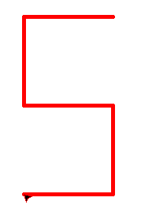
倒计时
turtle.clear()
#5
turtle.pu()
turtle.goto(40,0)
turtle.seth(45)
turtle.circle(80,90,1)
turtle.pd()
turtle.circle(80,180,2)
turtle.seth(45)
turtle.circle(-80,270,3)
time.sleep(0.7)

Slide 14
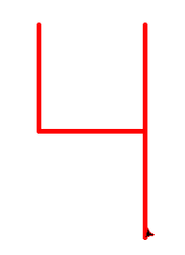
倒计时
turtle.clear()
#4
turtle.pu()
turtle.goto(40,0)
turtle.seth(45)
turtle.pd()
turtle.circle(80,90,1)
turtle.pu()
turtle.circle(80,90,1)
turtle.pd()
turtle.circle(80,180,2)
turtle.seth(-45)
turtle.circle(-80,90,1)
time.sleep(0.7)

Slide 15
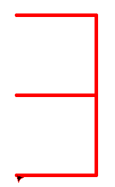
倒计时
turtle.clear()
#3
turtle.pu()
turtle.goto(40,0)
turtle.seth(45)
turtle.pd()
turtle.circle(80,-90,1)
turtle.pu()
turtle.circle(80,-90,1)
turtle.pd()
turtle.circle(80,-180,2)
turtle.seth(-45)
turtle.circle(-80,180,2)
time.sleep(0.7)

Slide 16
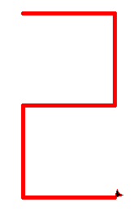
倒计时
turtle.clear()
#2
turtle.pu()
turtle.goto(40,0)
turtle.seth(45)
turtle.pu()
turtle.circle(80,-180,2)
turtle.pd()
turtle.circle(80,-270,3)
turtle.seth(45)
turtle.circle(-80,-180,2)
time.sleep(0.7)

Slide 17
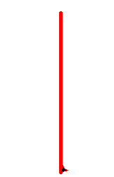
倒计时
turtle.clear()
#1
turtle.pu()
turtle.goto(40,0)
turtle.seth(45)
turtle.pd()
turtle.circle(80,90,1)
turtle.circle(80,-90,1)
turtle.seth(-45)
turtle.circle(-80,90,1)
time.sleep(0.7)

Slide 18
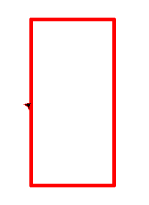
倒计时
turtle.clear()
#0
turtle.pu()
turtle.goto(40,0)
turtle.seth(45)
turtle.circle(80,-90,1)
turtle.pd()
turtle.circle(80,-270,3)
turtle.seth(-45)
turtle.circle(-80,270,3)
time.sleep(0.7)

Slide 19
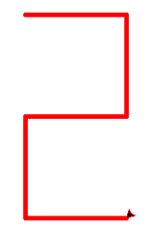
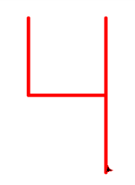
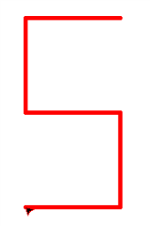
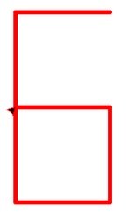
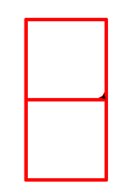
知识点总结
turtle.clear()
#8
turtle.pu()
turtle.goto(40,0)
turtle.pd()
turtle.seth(45)
turtle.circle(80,-360,4)
turtle.seth(-45)
turtle.circle(-80,360,4)
time.sleep(1)
实现倒计时功能：
擦除上一个数字 turtle.clear()
引入了time模块 import time
使用circle函数的三个参数，分别来表示半径、弧度和边数。
模拟倒计时1s sleep(1)
例子：数字8

Slide 20
03
Part three
课后作业

Slide 21
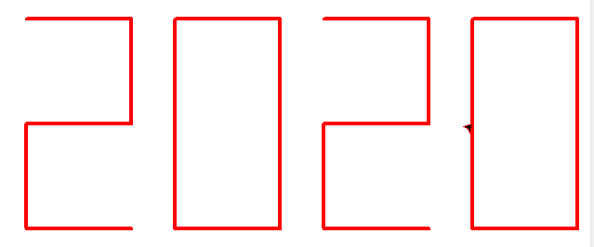
课后作业
试着用turtle画出今年的年份2020

Slide 22
import turtle
turtle.pencolor("red")
turtle.pensize(4)
#2
turtle.pu()
turtle.goto(-160,0)
turtle.seth(45)
turtle.pu()
turtle.circle(80,-180,2)
turtle.pd()
turtle.circle(80,-270,3)
turtle.seth(45)
turtle.circle(-80,-180,2)
#0
turtle.pu()
turtle.goto(0,0)
turtle.seth(45)
turtle.circle(80,-90,1)
turtle.pd()
turtle.circle(80,-270,3)
turtle.seth(-45)
turtle.circle(-80,270,3)
课后作业
#2
turtle.pu()
turtle.goto(160,0)
turtle.seth(45)
turtle.pu()
turtle.circle(80,-180,2)
turtle.pd()
turtle.circle(80,-270,3)
turtle.seth(45)
turtle.circle(-80,-180,2)
#0
turtle.pu()
turtle.goto(320,0)
turtle.seth(45)
turtle.circle(80,-90,1)
turtle.pd()
turtle.circle(80,-270,3)
turtle.seth(-45)
turtle.circle(-80,270,3)

Slide 23
THANK YOU
教师：赵老师

